Slide 1
Summarizing Fundamental Security Concepts
CompTIA Security+ Exam SY0-701
Lesson 1
Notes:
This lesson aims to establish the context for the security role and introduce the concepts of security controls and frameworks.

Slide 2
Objectives
Summarize information security concepts
Compare and contrast security control types
Describe security roles and responsibilities

Slide 3
Security Concepts
Lesson 1
Topic 1A
Notes:
This topic introduces the concepts of the CIA triad, access control, and use of frameworks to drive selection of controls and evaluate security maturity (gap analysis).
These concepts are deemed fundamental in objective 1.2. The zero trust, physical security, and deception/disruption subobjectives are covered later in the course.

Slide 4
Information Security
Confidentiality​
  Information should only be read by authorized persons
Integrity​
  Data is stored and transferred as intended and any modification is authorized​
Availability​
  Information is accessible to those authorized to view or modify it​
Non-repudiation​
  Persons cannot deny creating or modifying data​
Notes:
Make sure that students can differentiate the goals of providing confidentiality, integrity, and availability (and non-repudiation). Note that the property of availability should not be overlooked.
An alternative acronym is PAIN (Privacy, Authentication, Integrity, Non-Repudiation). We will discuss security versus privacy later in the course.

Slide 5
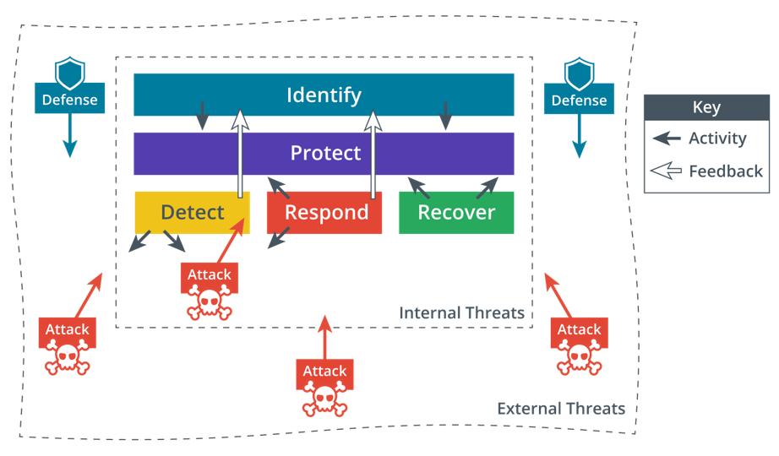
Cybersecurity Framework
Notes:
Use these functions to give students an overview of typical cybersecurity operations.
Make sure students are familiar with the work of NIST. Note also that links in the course will often include sites and white papers with considerable amounts of additional detail. This detail is not necessary to learn for the exam.
Start to develop the idea that cybersecurity is adversarial in nature, with threat actors continually seeking new advantages over defensive systems.

Slide 6
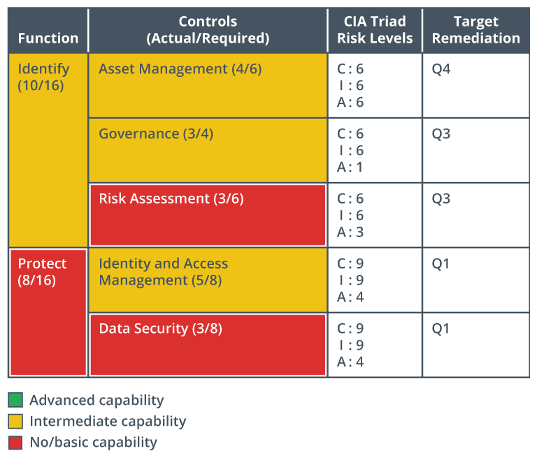
Gap Analysis
Notes:
Businesses might be framework oriented, or they might need to use a framework because of a legal or regulatory requirement.
This section is only intended to provide an overview of the basic concepts. Risk management is covered in detail in the last part of the course.

Slide 7
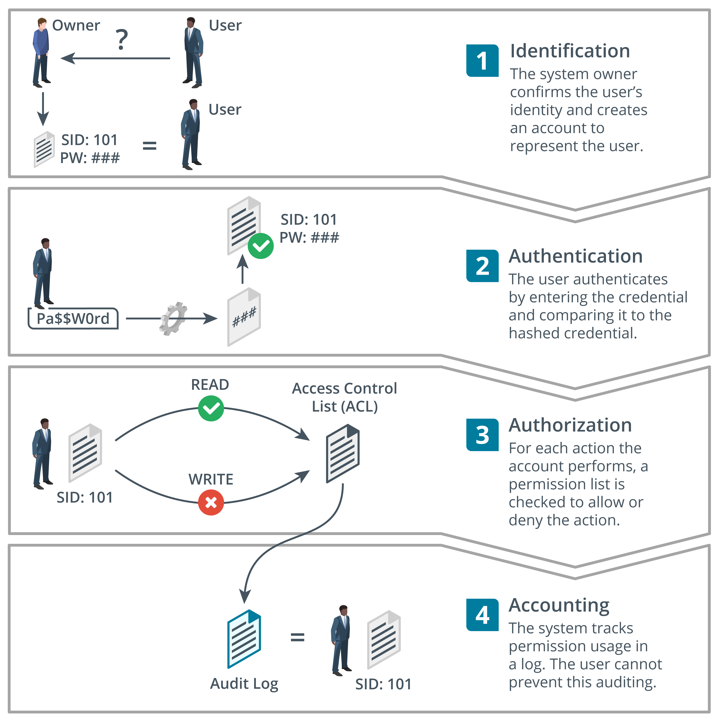
Access Control
Notes:
Stress the distinction between identification (performing identity proofing and creating a user account) and authentication (the process that proves that a user account is being accessed by the user for whom it was created).
The term "IAM" reflects the importance of the identification component, which is omitted in the earlier AAA framework.
Note that this topic provides an overview of general concepts. Details of authentication systems and authorization models are presented later in the course.

Slide 8
Security Concepts
Information security
  CIA triad
Cybersecurity framework
Gap analysis
Access control
  IAM and AAA
Notes:
You can either complete the review questions in class with the students or simply make them aware of them as resources to use as they review the course material before the exam. Students can also review additional practice questions from the Practice tab for the course on the CompTIA Learning Center (https://learn.comptia.org/login). Note that the exam itself features multiple-choice questions. A multiple-choice practice test featuring questions and domain weightings similar to the actual exam is also available on the CompTIA Learning Center.

Slide 9
Assisted Lab: Exploring the Lab Environment
Assisted Lab: Perform System Configuration Gap Analysis

Slide 10
Security Controls
Lesson 1
Topic 1B
Notes:
This is an important subject—students need to be able to distinguish between types of security controls.

Slide 11
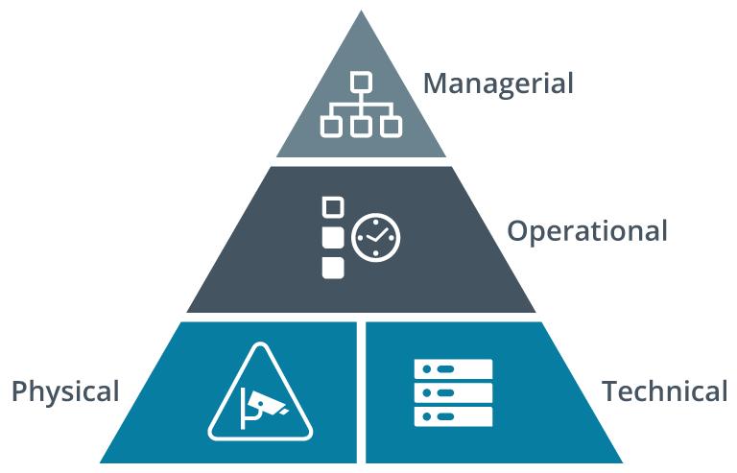
Security Control Categories​
Managerial​
  Give oversight of system​
Operational​
  Relies on a person for implementation​
Technical​
  Implemented in operating systems, software, and security appliances​
Physical
  Devices that mediate access to premises and hardware
Notes:
Explain that a control category describes how it is implemented. For example, a document access policy is managerial, checking that permissions are applied according to the policy is operational, and the file system permissions are technical in nature. As with all classification systems, there is some degree of overlap, but the classification process is designed to help assess capabilities compared to frameworks and best practice guides.

Slide 12
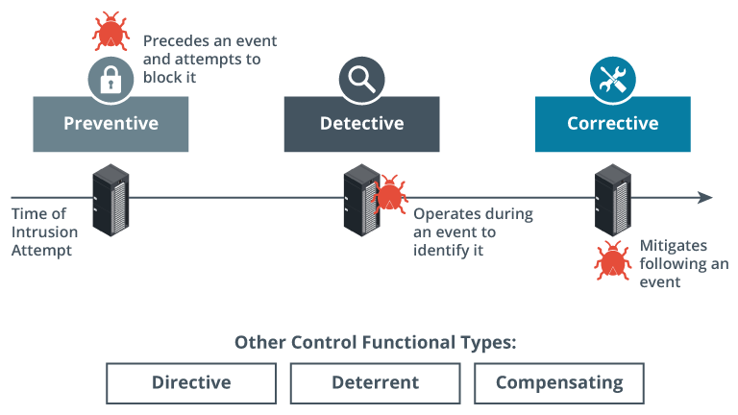
Security Control Functional Types (1)​
Preventive​
  Physically or logically restricts unauthorized access​
  Operates before an attack​
Detective​
  Identifies attempted or successful intrusion​s
  Operates during an attack​
Corrective​
  Responds to and fixes an incident and may prevent its reoccurrence​
  Operates after an attack​​
Images © 123rf.com.
Notes:
Where the category describes the implementation type, a functional type describes the control's purpose.
Get the students to nominate examples of different types of controls:
Preventive—permissions policy, encryption, firewall, barriers, locks
Detective—alarms, monitoring, file verification
Corrective—incident response policies, data backup, patch management

Slide 13
Security Control Functional Types (2)​
Directive​
  Enforces a rule of behavior
Deterrent​
  Psychologically discourages intrusion​s
Compensating​
  Substitutes for a principal control​
  Associated with framework compliance measures

Slide 14

Information Security Roles and Responsibilities​
Overall responsibility​
  Chief Information Officer (CIO)​
  Chief Security Officer (CSO)​
Managerial​
Technical​
  Information Systems Security Officer (ISSO)​
Non-technical​
Due care/liability​
Image credit: Shannon Fagan © 123rf.com.
Notes:
Students should learn this terminology, drawn from the acronym list. Note the advice in the syllabus document: "Candidates are encouraged to review the complete list and attain a working knowledge of all listed acronyms as part of a comprehensive exam preparation program.“
Discuss how responsibility for security might need to be clarified when there is a specialist security function combined with the responsibilities of different department managers.

Slide 15
Information Security Competencies​
Risk assessments and testing​
Specifying, sourcing, installing, and configuring secure devices and software​
Access control and user privileges​
Auditing logs and events​
Incident response​ and reporting
Business continuity and disaster recovery​
Security training and education programs​
Notes:
If appropriate, ask students what security-relevant duties they have in their current employment.

Slide 16

Information Security Business Units​
Security Operations Center (SOC)​
DevSecOps​
  Development, security, and operations​
Incident response​
  Cyber incident response team (CIRT)​
Image © gorodenkoff 123RF.com
Notes:
If appropriate, discuss how the security function is represented in the students' workplaces. Do any students currently work in a SOC or participate in DevSecOps projects?

Slide 17
Security Controls
Security control categories​
  Managerial, operational, technical, physical
Security control functional types
  Preventive, detective, corrective plus directive, deterrent, compensating
Information security roles and responsibilities​
Information security competencies​
Information security business units​
  SOC, DevSecOps, and CIRT

Slide 18
Assisted Lab: Configuring Examples of Security Control Types

Slide 19
Summary
CompTIA Security+ Exam SY0-701
Lesson 1
Notes:
Check that students are confident about the content that has been covered. If there is time, revisit any content examples that they have questions about. If you have used all the available time for this lesson block, note the issues and schedule time for a review later in the course.
Optionally, discuss with students how the concepts from this lesson could be used within their own workplaces, or how these principles are already being put into practice.

